Slide 1
QnA
Freshman Seminar
2022.01.25.
Sumin Sohn

Slide 2
Type of Attacks
Known plaintext attack
The attacker knows all of plaintext ciphertext pairs
Goal is to derive the key
Chosen plaintext attack
The attacker can encrypt plaintext message
Goal is to derive the key
Known ciphertext attack
The attacker has access only to a set of ciphertexts
Chosen ciphertext attack
The attacker can decrypt ciphertext

Slide 3
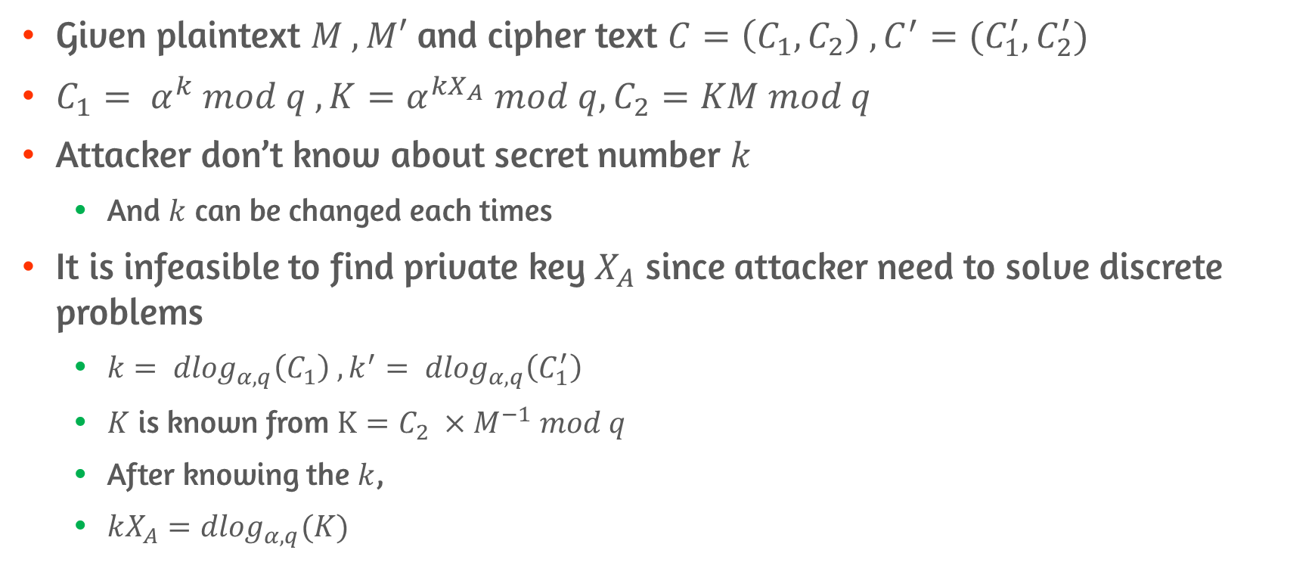
Known/Chosen Plaintext Attack on Elgamal Cryptosystem
Given plaintext $M , M′$ and cipher text $C=\left(C_{1},C_{2}\right) , C^{′}=(C_{1}^{′}, C_{2}^{′})$
$C_{1}= α^{k} mod q , K=α^{kX_{A}} mod q, C_{2}=KM mod q$
Attacker don’t know about secret number $k$
And $k$ can be changed each times
It is infeasible to find private key $X_{A}$ since attacker need to solve discrete problems
$k= {dlog}_{α,q}\left(C_{1}\right) ,k^{′}= {dlog}_{α,q}\left(C_{1}^{′}\right)$
$K$ is known from $K=C_{2} ×M^{−1} mod q$
After knowing the $k$,
$kX_{A}={dlog}_{α,q}(K)$

Slide 4

Known Ciphertext Attack on Elgamal Cryptosystem
Attacker only knows about $C=\left(C_{1},C_{2}\right) , C^{′}=(C_{1}^{′}, C_{2}^{′})$
The condition is similar to plain text attacks
Attacker doesn’t even know about $K$

Slide 5
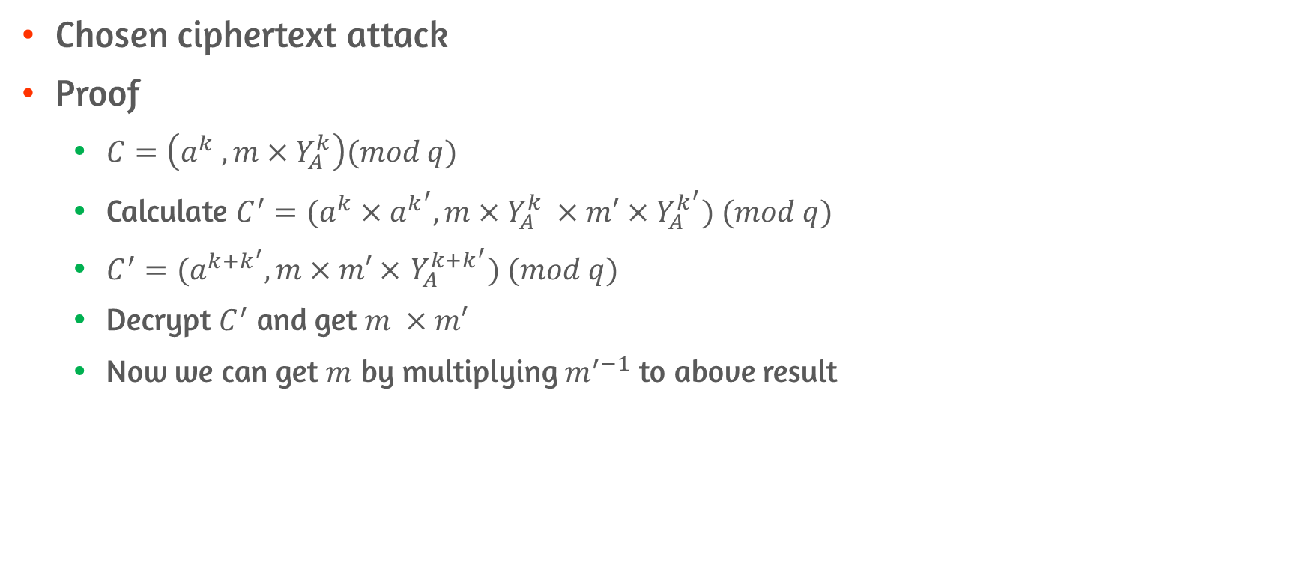
Q1. Which type of attack is effective to Elgamal cryptographic system?
Chosen ciphertext attack
Proof
$C=\left(a^{k} , m×Y_{A}^{k}\right)(mod q)$
Calculate $C^{′}=(a^{k}×a^{k^{′}},m×Y_{A}^{k} ×m′×Y_{A}^{k^{′}}) (mod q)$
$C^{′}=(a^{k+k^{′}},m×m′×$ $Y_{A}^{k+k^{′}}) (mod q)$
Decrypt $C^{′}$ and get $m ×m′$
Now we can get $m$ by multiplying $m^{′−1}$ to above result

